Slide 1
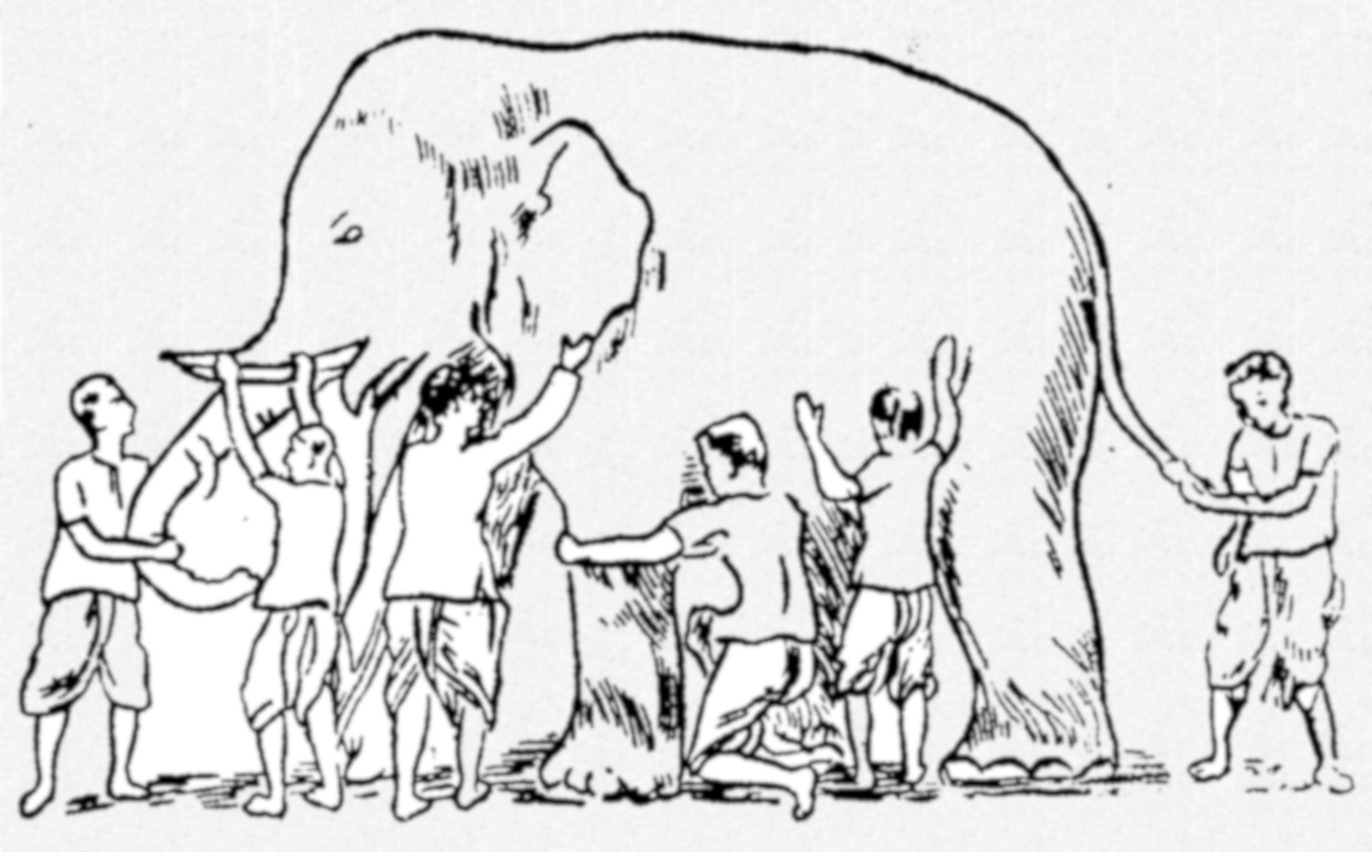
Why Ensemble Works?
Some unknown distribution
Model 1
Model 6
Model 3
Model 5
Model 2
Model 4
Ensemble gives the global picture!
W. Fan, Random Decision Tree.

Slide 3
The basic process of cluster ensembles
P₁
Clustering 1
P
P₂
Consensus Function
Clustering 2
Clustering N
P_{N}

Slide 4
Challenge I: how to generate clustering ensembles?
Using different clustering algorithms
E.g. K-means, Hierarchical Clustering, Fuzzy C-means, Spectral Clustering, Gaussian Mixture Model,….
Running the same algorithm many times with different parameters or initializations, e.g.,
run K-means algorithm N times using randomly initialized clusters centers
use different dissimilarity measures
use different number of clusters
Using different samples of the data
E.g. many different samples from a given data
Random projections (feature extraction)
E.g. project the data onto a random subspace
Feature selection
E.g. use different subsets of features

Slide 5
Challenge II: how to combine multiple partitions?
According to (Vega-Pons & Ruiz-Shulcloper, 2011), ensemble clustering algorithms can be divided into
Median partition based approaches
Object co-occurrence based approaches
Relabeling/voting based methods
Co-association matrix based methods
Graph based methods

Slide 6
Median partition-based approaches
Basic idea: find a partition P that maximizes the similarity between P and all the N partitions in the ensemble, i.e., P1, P2, …, PN
Need to define the similarity between two partitions
Normalized mutual information (Strehl & Ghosh, 2002)
Utility function (Topchy, Jain, and Punch, 2005)
Purity and inverse purity (Zhao & Karypis, 2005)
P2
P1
P3
P
….
PN
PN-1

Slide 7
Relabeling/voting based methods
First find the corresponding cluster labels among multiple partitions, then obtain the consensus partition through a voting process. (Ayad & Kamel, 2007; Dimitriadou et. al, 2002; Dudoit & Fridlyand, 2003; Fischer & Buhmann, 2003; Tumer & Agogino, 2008; etc)
Re-labeling
Voting
 | P₁ | P₂ | P₃
v₁ | 1 | 3 | 2
v₂ | 1 | 3 | 2
v₃ | 2 | 1 | 2
v₄ | 2 | 1 | 3
v₅ | 3 | 2 | 1
v₆ | 3 | 2 | 1
 | P₁ | P₂ | P₃
v₁ | 1 | 1 | 1
v₂ | 1 | 1 | 1
v₃ | 2 | 2 | 1
v₄ | 2 | 2 | 2
v₅ | 3 | 3 | 3
v₆ | 3 | 3 | 3
P*
1
1
2
2
3
3
Hungarian
algorithm

Slide 8
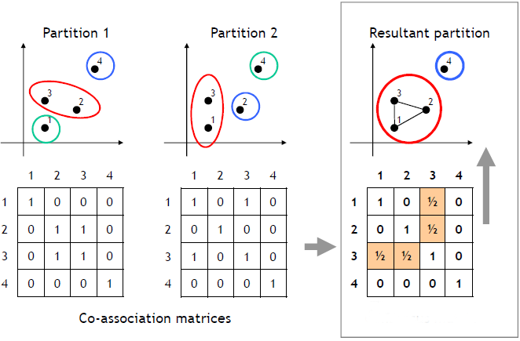
Co-association matrix based methods
First compute a co-association matrix based on multiple data partitions, then apply a similarity-based clustering algorithm to the co-association matrix to obtain the final partition of the data. (Fred & Jain, 2005; Iam-On et. al, 2008; Vega-Pons & Ruiz-Shulcloper, 2009; Wang et. al, 2009; Li et. al, 2007; etc)

Slide 9
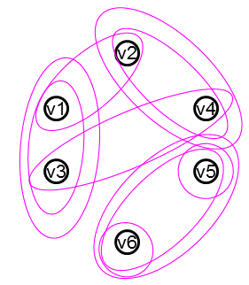
Graph based methods
Construct a weighted graph to represent multiple clustering results from the ensemble, then find the optimal partition of data by minimizing the graph cut (Fern & Brodley, 2004; Strehl & Ghosh, 2002; etc)
 | P₁ | P₂ | P₃
v₁ | 1 | 1 | 1
v₂ | 1 | 2 | 2
v₃ | 2 | 1 | 1
v₄ | 2 | 2 | 2
v₅ | 3 | 3 | 3
v₆ | 3 | 4 | 3
P*
1
2
1
2
3
3
Graph
Clustering

Slide 10
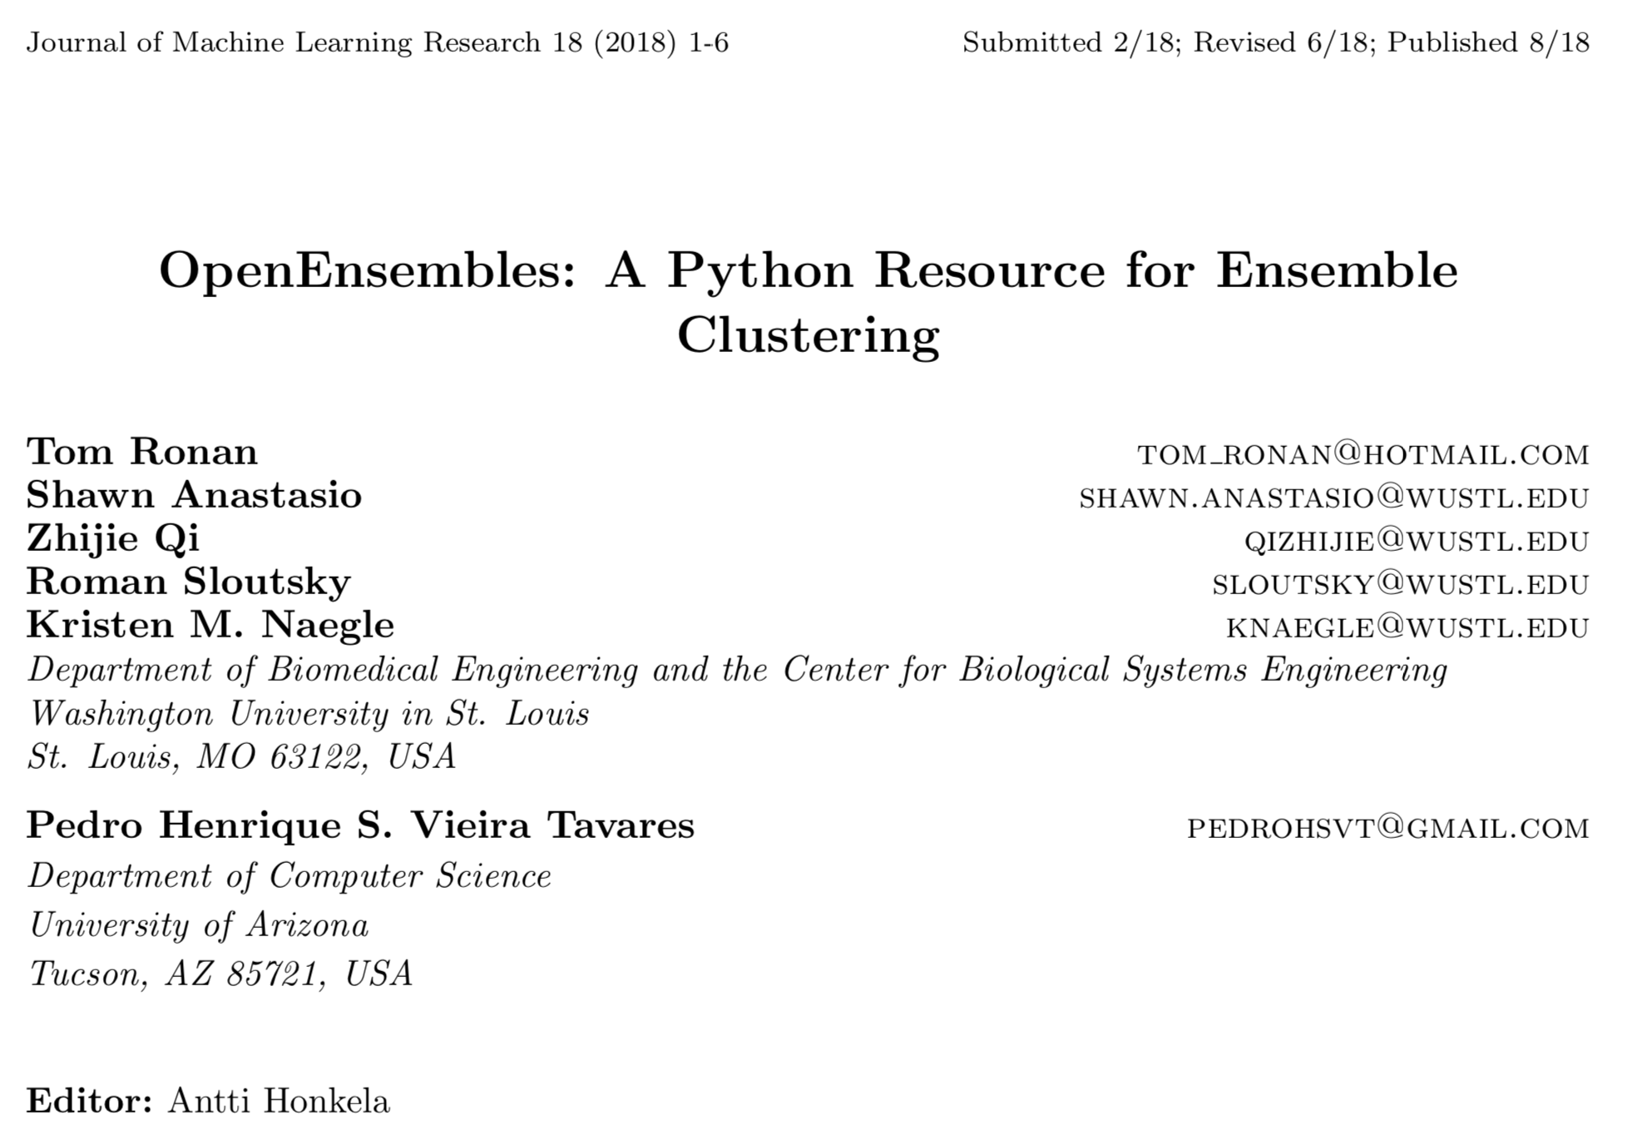

Slide 12
There are three main OpenEnsembles classes that pair with the main aspects of ensemble clustering:
Data (storing and manipulating data)
Cluster (clustering data)
Validation (assessing the degree of success of a clustering solution according to an objective such as compactness or connectedness).

Slide 13
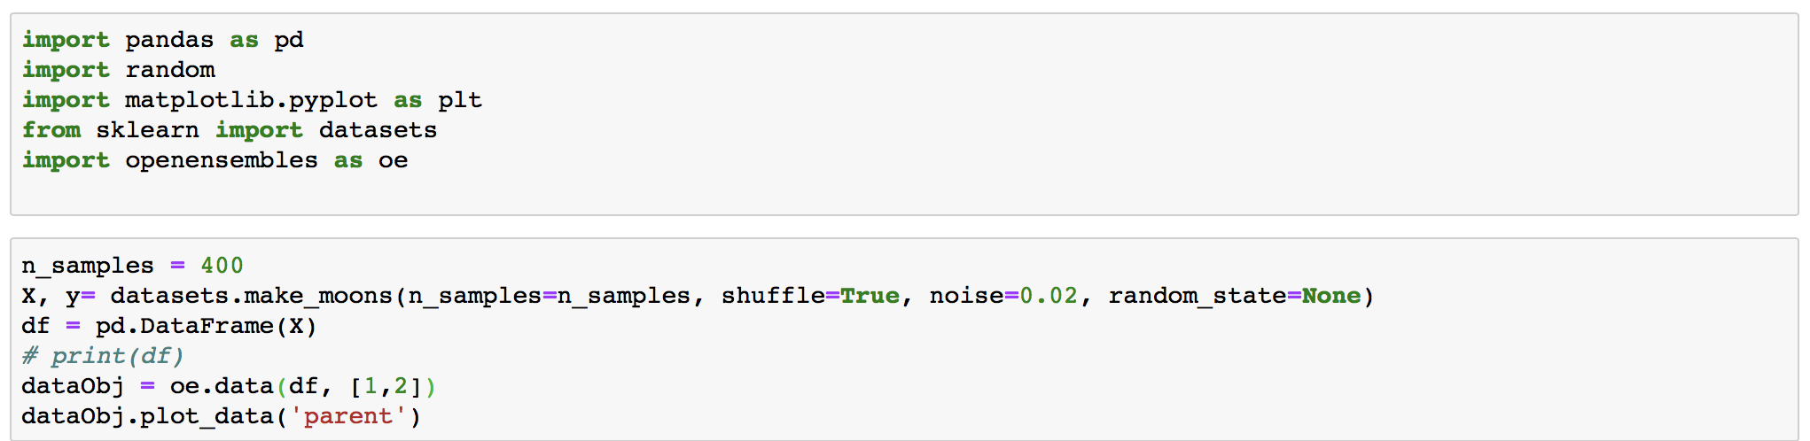

Slide 14
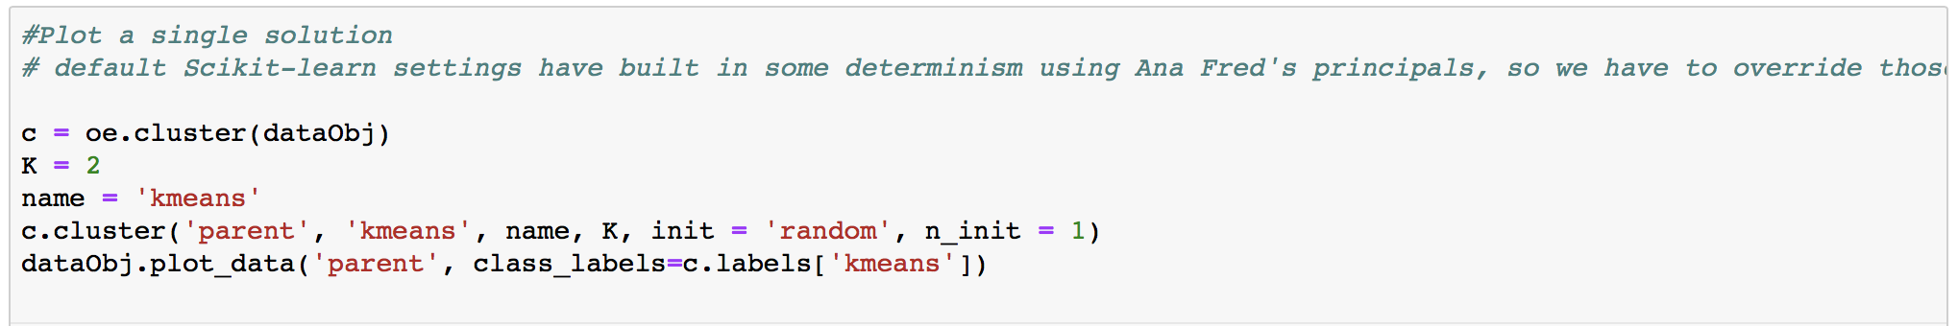

Slide 15
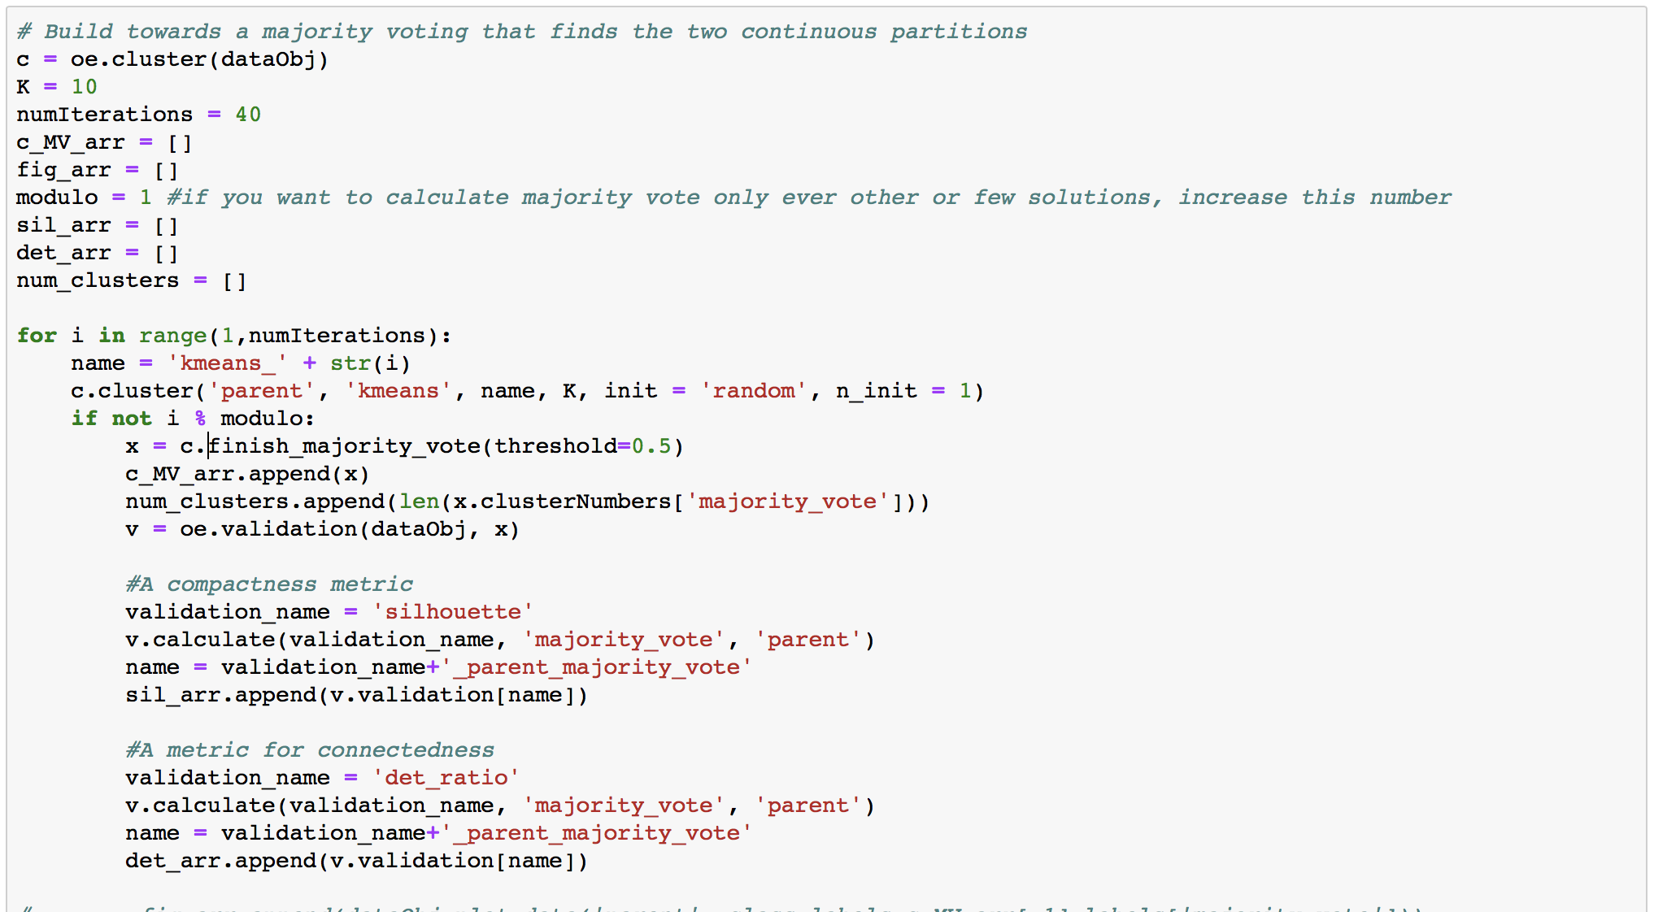

Slide 17
Ensemble Clustering

Slide 18
K-mean Clustering
Ensemble Clustering

